Slide 1



Noida Institute of Engineering and Technology, Greater Noida
Code Generation
Unit: 5
Compiler Design
Vivek Kumar Sharma
Assistant Professor
CSE
Course Details (B Tech 5th Sem)

Slide 2
Brief Introduction of Faculty
Vivek Kumar Sharma
Designation: Assistant Professor CSE Department
NIET Grater Noida
Qualifications:
B.Tech (CSE) in 2010
M.Tech (CSE) in 2013
Teaching Experinces : 10+ year
Research Publications:
Particulars | Journals (UGC) | Conference(IEEE)
International | 04 | 02
National | 01 | 00

Slide 3
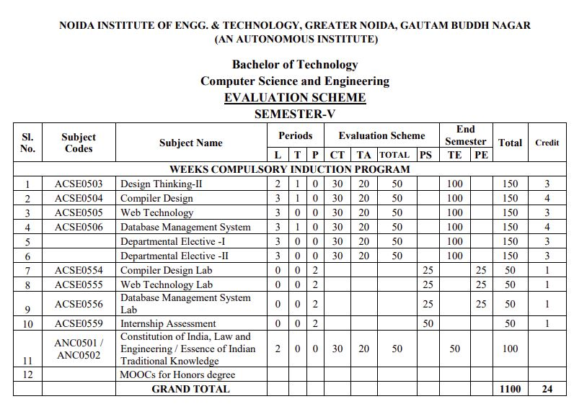
Evaluations Scheme

Slide 4
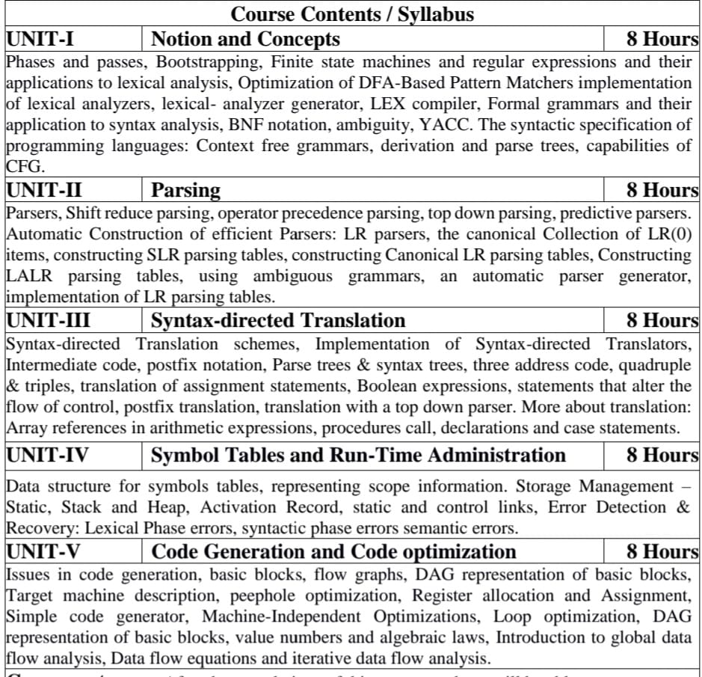
Syllabus

Slide 5
Branch Wise Application
Computer Science
Compiler technology can be used to translate the binary code for one machine to that of another, allowing a machine to run programs originally compiled for another instruction set. Binary translation technology has been used by various computer companies to increase the availability of software for their machines
Implementations of High Level Programming
Optimization of Computer Architecture
Design of New Computer Architecture
Program Translation
Software Productive tools

Slide 6
Course Objective
A course in Compiler Design aims to impart comprehensive knowledge and skills essential for designing, implementing, and optimizing compilers.
Students learn the theoretical foundations including formal languages, automata theory, and parsing techniques, which are applied practically in understanding compiler structure and components such as lexical analysis, syntax analysis, semantic analysis, intermediate code generation, optimization, and code generation.
They gain proficiency in using tools like lex/yacc and others to implement these concepts in real-world scenarios. Emphasis is placed on error handling, debugging techniques, and the application of optimizations to improve the efficiency of generated code.
By the end of the course, students are prepared to tackle challenges in compiler development, contributing to language design.

Slide 7
Course Outcome
After the completions of this course students will be able to
CO-1 Identify and interpret the different phases of a compiler and their functioning
CO-2 Design and implement Syntax Analyzer
CO-3 Specify appropriate translations to generate an intermediate code for the given programming language constructs.
CO-4 Design and develop various data structure for symbols tables and Error Detection & Recovery at every phase.
CO-5 Apply various new code optimization techniques to improve the performance of a program in terms of speed & space.

Slide 8
Program Outcomes (PO)
PO1: Engineering Knowledge
PO2: Problem Analysis
PO3: Design/Development of solutions
PO4: Conduct Investigations of complex problems
PO5: Modern tool usage
PO6: The engineer and society
PO7: Environment and sustainability
PO8: Ethics
PO9: Individual and team work
PO10: Communication
PO11: Project management and finance
PO12: Life-long learning

Slide 9
CO-PO Mapping
Sr. No | Course Outcome | PO1 | PO2 | PO3 | PO4 | PO5 | PO6 | PO7 | PO8 | PO9 | PO10 | PO11 | PO12
1 | ACSE0504.1 | 3 | 3 | 2 | 3 | 1 | - | - | - | 1 | - | - | 2
2 | ACSE0504.2 | 3 | 3 | 3 | 3 | 1 | - | - | 1 | 1 | - | - | 2
3 | ACSE0504.3 | 3 | 3 | 3 | 3 | - | - | - | 1 | 1 | - | - | 2
4 | ACSE0504.4 | 3 | 2 | 2 | 2 | - | - | - | 1 | 1 | - | - | 2
5 | ACSE0504.5 | 3 | 3 | 3 | 3 | - | - | - | 1 | 1 | - | - | 2
6 | Average | 3 | 2.8 | 2.6 | 2.8 | .4 | - | - | .8 | 1 | - | - | 2

Slide 10
Program Specific Outcomes (PSO)
PSO1: The ability to identify, analyze real world problems and design their ethical solutions using artificial intelligence, robotics, virtual/augmented reality, data analytics, block chain technology, and cloud computing.
PSO2:The ability to design and develop the hardware sensor devices and related interfacing software systems for solving complex engineering problems.
PSO 3:The ability to understand inter-disciplinary computing techniques and to apply them in the design of advanced computing.
PSO 4:The ability to conduct investigation of complex problems with the help of technical, managerial, leadership qualities, and modern engineering tools provided by industry-sponsored laboratories.

Slide 11
CO-PSO Mapping
 | PSO1 | PSO2 | PSO3 | PSO4
ACSE0504.1 | 3 | 2 | 3 | 2
ACSE0504.2 | 3 | 3 | 3 | 2
ACSE0504.3 | 3 | 3 | 3 | 2
ACSE0504.4 | 3 | 2 | 2 | 2
ACSE0504.5 | 3 | 2 | 3 | 2
Average | 3 | 2.2 | 2.8 | 2

Slide 12
Program Educational Objectives
The graduates will be able:
PEO1: To have an excellent scientific and engineering breadth to comprehend, analyze, design and provide sustainable solutions for real-life problems using state-of-the-art technologies.
PEO2:To have a successful career in industries, to pursue higher studies or to support entrepreneurial endeavors and to face global challenges.
PEO3:To have an effective communication skill, professional attitude, ethical values and a desire to learn specific knowledge in emerging trends, technologies for research, innovation and product development and contribution to society.
PEO4: To have life-long learning for up-skilling and re-skilling for successful professional career as engineer, scientist, entrepreneur, and bureaucrat for betterment of society.

Slide 13
Result Analysis
Compiler Design :
2022-2023 : Section D :100%
2023-2024 : Section A : 100%
Section D : 100%

Slide 14
End Semester Question Paper Template
B TECH
(SEM-V) THEORY EXAMINATION 20__-20__
COMPILER DESIGN
Time: 3 Hours Total Marks: 100
Note: 1. Attempt all Sections. If require any missing data; then choose suitably.
SECTION A 2*10= 20
Attempt all parts 1 x 10 = 10
Q.No | Question | Marks | CO
1.a |  | 1 | 1
1.b |  | 1 | 1
.. |  | 1
1.j |  | 1 | 5

Slide 15
End Semester Question Paper Templates
2. Attempt all parts:- 5*2 = 10
Q.No | Question | Marks | CO
2.a |  | 2 | 1
2.b |  | 2 | 2
2.c |  | 2 | 3
2.d |  | 2 | 4
2.e |  | 2 | 5
Section : B
3. Answer any five of the following:- 5*6=30
Q.No | Question | Marks | CO
3.a |  | 6 | 1
3.b |  | 6 | 1
….. |  | 6 | ..
3.g |  | 6 | 5

Slide 16
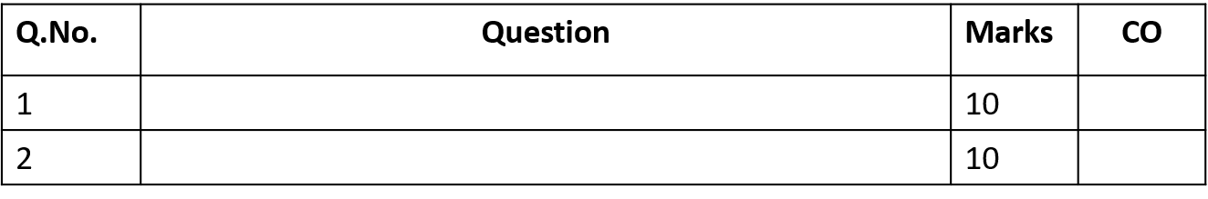
End Semester Question Paper Templates
Section : C
4. Attempt any one part of the following: 1 x 10 = 10
5. Attempt any one part of the following: 1 x 10 = 10
6. Attempt any one part of the following: 1 x 10 = 10

Slide 17
End Semester Question Paper Templates
7. Attempt any one part of the following: 1 x 10 = 10
8. Attempt any one part of the following: 1 x 10 = 10

Slide 18
Prerequisite
.
Automata Theory
Context Free Languages
Data Structure
Logic or Algebra
Simple Graph Algorithms
Computer Architecture

Slide 19
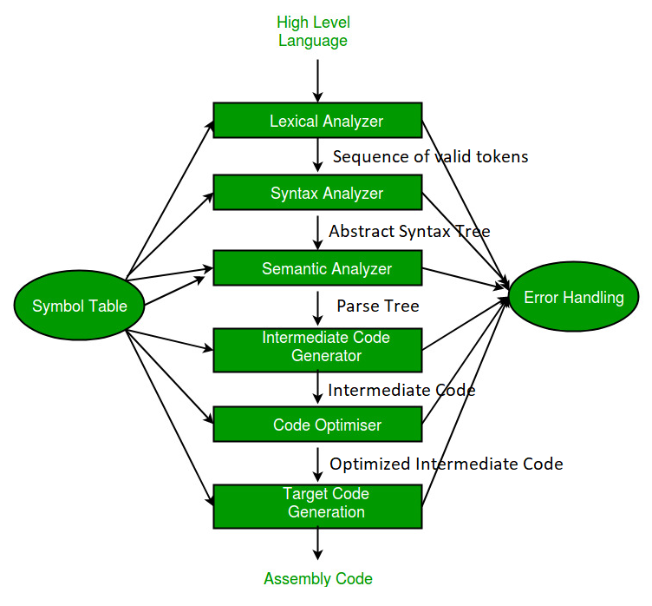
RECAP
Analysis
(Frontend)
Synthesis
(Backend)

Slide 20
Brief Introduction about the Subject with video
Compiler design principles provide an in-depth view of translation and optimization process. Compiler design covers basic translation mechanism and error detection & recovery. It includes lexical, syntax, and semantic analysis as front end, and code generation and optimization as back-end.
https://youtu.be/Qkwj65l_96I
https://youtu.be/WccZQSERfCM
https://youtu.be/j-bLeUysUiE

Slide 21
Unit Content
Code Generation
Design Issues, the target language
Address in the Target Code
Code Optimization
Machine Independent Optimizations
Loop optimization
DAG representation of basic blocks
Optimization of Basic Blocks
Basic Blocks and Flow Graphs
Code Generator
Global Data- Flow analysis

Slide 22
Objective of Unit
Topic | Objective
Code generation | To learn about the design issues in code generation
Target Machine | Understand the different target machine for which compiler can create target code.
Basic Block | To know about basic block and also learn the partitioning algorithm to convert any code to different blocks.
Code Optimization | To understand the different algorithm to optimize the code i.e. looping optimization, peephole optimization ,DAG etc.

Slide 23
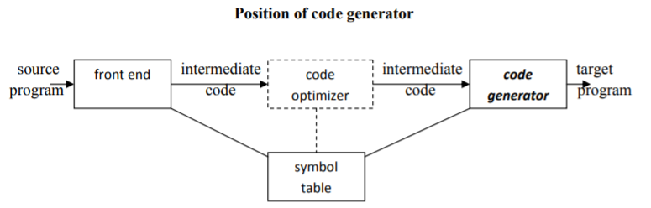
Code Generation(CO5)
output code must be correct
output code must be of high quality
code generator should run efficiently

Slide 24
Issues in the design of code generator
In the code generation phase, various issues can arises:
Input to the code generator
Target program
Memory management
Instruction selection
Register allocation
Evaluation order

Slide 25
1. Input to the code generator
The input to the code generator contains the intermediate representation of the source program and the information of the symbol table. The source program is produced by the front end.
Intermediate representation has the several choices:
a) Postfix notation b) Syntax tree c) Three address code
We assume front end produces low-level intermediate representation i.e. values of names in it can directly manipulated by the machine instructions.
The code generation phase needs complete error-free intermediate code as an input requires.

Slide 26
2. Target program:
The target program is the output of the code generator. The output can be:
Assembly language: It allows subprogram to be separately compiled.
Relocatable machine language: It makes the process of code generation easier.
Absolute machine language: It can be placed in a fixed location in memory and can be executed immediately.

Slide 27
3. Memory management
During code generation process the symbol table entries have to be mapped to actual addresses and levels have to be mapped to instruction address.
Mapping name in the source program to address of data is co-operating done by the front end and code generator.
Local variables are stack allocation in the activation record while global variables are in static area.

Slide 28
4. Instruction selection:
Nature of instruction set of the target machine should be complete and uniform.
When you consider the efficiency of target machine then the instruction speed and machine idioms are important factors.
The quality of the generated code can be determined by its speed and size.

Slide 29
Example
The Three address code is:
a:= b + c
d:= a + e
Inefficient assembly code is:
MOV b, R0 R0 → b
ADD c, R0 R0 c + R0
MOV R0, a a → R0
MOV a, R0 R0 → a
ADD e, R0 R0 → e + R0
MOV R0, d d → R0

Slide 30
5. Register allocation
Register can be accessed faster than memory. The instructions involving operands in register are shorter and faster than those involving in memory operand.
The following sub problems arise when we use registers:
Register allocation: In register allocation, we select the set of variables that will reside in register.
Register assignment: In Register assignment, we pick the register that contains variable.
Certain machine requires even-odd pairs of registers for some operands and result.

Slide 31
Example:
Consider the following division instruction of the form:
D x, y
Where,
x is the dividend even register in even/odd register pair
y is the divisor
Even register is used to hold the reminder.
Odd register is used to hold the quotient

Slide 32
6. Evaluation order
The efficiency of the target code can be affected by the order in which the computations are performed.
Some computation orders need fewer registers to hold results of intermediate than others

Slide 33
Target language (CO5)
The target language nature for which the code is to be transformed is to be known by the code generator.
Some machine-specific instructions are facilitated by the language enabling the compiler to generate the code in a convenient manner.

Slide 34
Target Machine
The target computer is a type of byte-addressable machine. It has 4 bytes to a word. The target machine has n general purpose registers, R0, R1,...., Rn-1.
It also has two-address instructions of the form:
op source, destination
Where, op is used as an op-code and source and destination are used as a data field.

Slide 35
Addressing Mode (CO5)
MODE | FORM | ADDRESS | ADDED COST
absolute | M | M | 1
register | R | R | 0
indexed | c(R) | C+ contents(R) | 1
indirect register | *R | contents(R) | 0
indirect indexed | *c(R) | contents(c+ contents(R)) | 1
literal | #c | c | 1

Slide 36
Example:
1. Move register to memory R0 → M
MOV R0, M
cost = 1+0+1 (since address of memory location M is in word following the instruction)
2. Indirect indexed mode
MOV * 4(R0), M
cost = 1+1+1 (since one word for memory location M, one word
for result of *4(R0) and one for instruction)

Slide 37
Example
3. Literal Mode:
MOV #1, R0
cost = 1+1+0 = 2 (one word for constant 1 and one for instruction)

Slide 38
Basic Block (CO5)
It is a straight line code sequence which has no in and out branches except to the entry and at the end respectively.
Basic Block is a set of statements which always executes one after other, in a sequence.
The first task is to partition a sequence of three-address code into basic blocks.
A new basic block is begun with the first instruction and instructions are added until a jump or a label is met.
In the absence of jump control moves further consecutively from one instruction to another.

Slide 39
Algorithm
Partitioning three-address code into basic blocks
Input: A sequence of three address instructions.
Process: Instructions from intermediate code where leaders are determined.
Following are the rules used for finding leader:
The first three-address instruction of the intermediate code is a leader.
Instructions which are targets of jump or conditional jump are leaders.
Instructions which immediately follows jump are considered as leaders.
For each leader thus determined its basic block contains itself and all instructions up to excluding the next leader

Slide 40
EXAMPLE
i=1
j=1
t1 = 10 * i
t2 = t1 + j
t3 = 8 * t2
t4 = t3 - 88
a[t4] = 0.0
j = j + 1
if j <= goto (3)
i = i + 1
if i <= 10 goto (2)
i = 1
t5 = i - 1
t6 = 88 * t5
a[t6] = 1.0
i = i + 1
if i <= 10 goto (13)

Slide 41
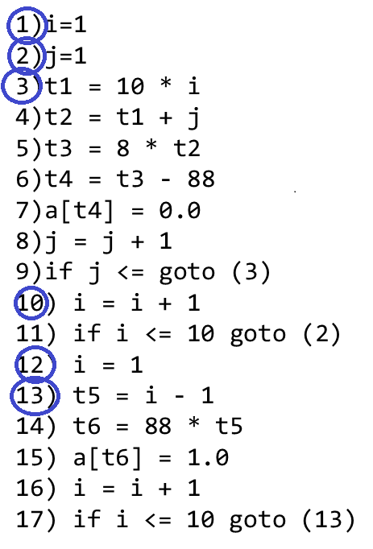
Leaders are marked with blue circle
.

Slide 42
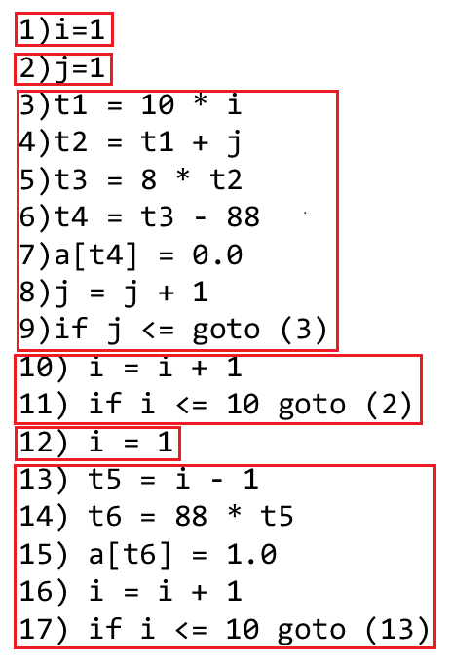
Basic Block

Slide 43
Flow Graph (CO5)
Flow graph is a directed graph. It contains the flow of control information for the set of basic block.
A control flow graph is used to depict that how the program control is being parsed among the blocks. It is useful in the loop optimization.

Slide 44
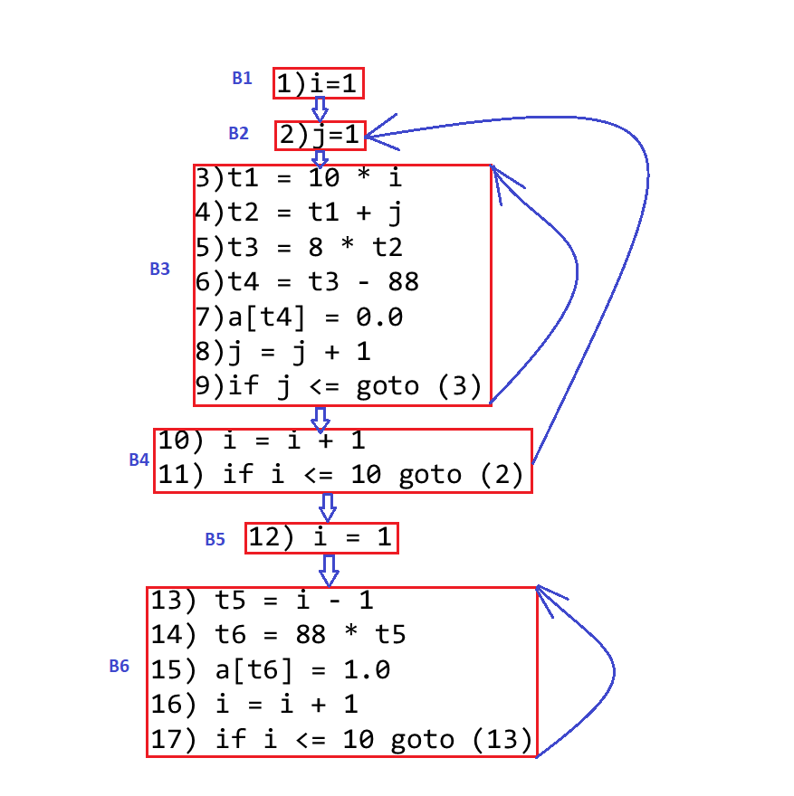
Algorithm

Slide 45
Optimization of Basic Blocks (CO5)
Optimization process can be applied on a basic block. While optimization, we don't need to change the set of expressions computed by the block.
There are two type of basic block optimization. These are as follows:
Structure-Preserving Transformations
Algebraic Transformations

Slide 46
1. Structure preserving transformations
The primary Structure-Preserving Transformation on basic blocks is as follows:
Common sub-expression elimination
Dead code elimination
Renaming of temporary variables
Interchange of two independent adjacent statements

Slide 47
(a) Common sub-expression elimination:
In the common sub-expression, we don’t want to computed it over and over again. Instead of this we can compute it once and kept in store from where it's referenced when encountered again.
3 address code Elimination sub-expression
a : = b + c a : = b + c
b : = a - d b : = a - d
c : = b + c c : = b + c
d : = a - d d : = b

Slide 48
(b) Dead-code elimination
It is possible that a program contains a large amount of dead code.
Suppose the statement x:= y + z appears in a block and x is dead symbol that means it will never subsequently used. Then without changing the value of the basic block you can safely remove this statement.
Eg:
a=0;
if(a==1) Dead Code
{ a=x+1 }

Slide 49
(c) Renaming temporary variables
A statement t:= b + c can be changed to u:= b + c where t is a temporary variable and u is a new temporary variable.
All the instance of t can be replaced with the u without changing the basic block value
Eg: Unoptimized block optimized block
t1=b+c t1=b+c
t2=a-t1 t2=a-t1
t1=t1*d t3=t1*d
d=t2+t1 d=t2+t3

Slide 50
(d) Interchange of statement
Suppose a block has the following two adjacent statements:
t1 : = b + c
t2 : = x + y
These two statements can be interchanged without affecting the value of block when value of t1 does not affect the value of t2.

Slide 51
2. Algebraic transformations
In the algebraic transformation, we can change the set of expression into an algebraically equivalent set. Thus the expression x:= x + 0 or x:= x *1 can be eliminated from a basic block without changing the set of expression.
Sometimes the unexpected common sub expression is generated by the relational operators like <=, >=, <, >, +, = etc.
Sometimes associative expression is applied to expose common sub expression without changing the basic block value. if the source code has the assignments
Eg: t1=a-a t1=0
t2=b-t1 t2=b

Slide 52
Code Generator
Code generator is used to produce the target code for three-address statements. It uses registers to store the operands of the three address statement
Example:
Consider the three address statement
x:= y + z.
It can have the following sequence of codes:
MOV z, R₀
ADD y, R₀
MOV R0 , x

Slide 53
Register and Address Descriptors
A register descriptor contains the track of what is currently in each register.
The register descriptors show that all the registers are initially empty.
An address descriptor is used to store the location where current value of the name can be found at run time.

Slide 54
A code-generation algorithm (CO5)
The algorithm takes a sequence of three-address statements as input. For each three address statement of the form a:= b op c perform the various actions.
These are as follows:
Invoke a function get reg to find out the location L where the result of computation b op c should be stored.
Consult the address description for y to determine y'. If the value of y currently in memory and register both then prefer the register y' . If the value of y is not already in L then generate the instruction MOV y' , L to place a copy of y in L.

Slide 55
A code-generation algorithm
Generate the instruction OP z' , L where z' is used to show the current location of z. If z is in both then prefer a register to a memory location. Update the address descriptor of x to indicate that x is in location L. If x is in L then update its descriptor and remove x from all other descriptor.
If the current value of y or z have no next uses or not live on exit from the block or in register then alter the register descriptor to indicate that after execution of x : = y op z those register will no longer contain y or z.

Slide 56
Generating Code for Assignment Statements
The assignment statement d:= (a-b) + (a-c) + (a-c) can be translated into the following sequence of three address code:
t:= a - b
u:= a - c
v:= t + u
d:= v + u

Slide 57
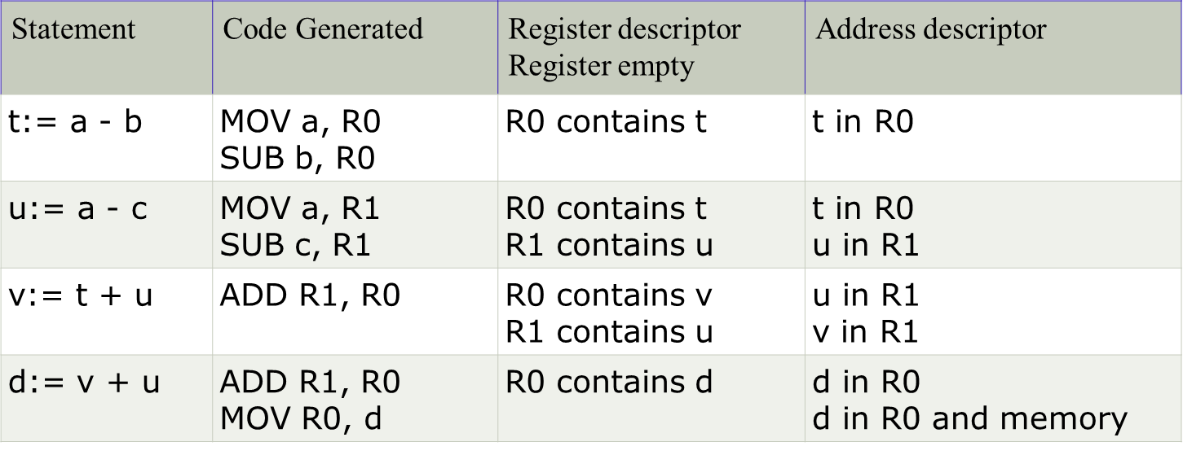
Code sequence for the example is as follows

Slide 58
Code Optimization (CO5)
The code optimization in the synthesis phase is a program transformation technique,
which tries to improve the intermediate code,
by making it consume fewer resources (i.e. CPU, Memory)
so that faster-running machine code will result.

Slide 59
Topic Objectives
Compiler optimizing process should meet the following objectives :
The optimization must be correct, it must not, in any way, change the meaning of the program.
Optimization should increase the speed and performance of the program.
The compilation time must be kept reasonable.
The optimization process should not delay the overall compiling process.

Slide 60
When to Optimize?
Efforts for an optimized code can be made at various levels of compiling the process.
At the beginning, users can change/rearrange the code or use better algorithms to write the code.
After generating intermediate code, the compiler can modify the intermediate code by address calculations and improving loops.
While producing the target machine code, the compiler can make use of memory hierarchy and CPU registers.

Slide 61
For example:
Do
{
item = 10;
value = value + item;
}
while(value<100);
This code involves repeated assignment of the identifier item, which if we put this way:
Should not only save the CPU cycles, but can be used on any processor.
Item = 10;
Do
{
value = value + item;
}
while(value<100);

Slide 62
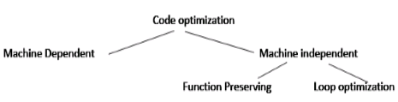
Types (CO5)

Slide 63
Machine Dependent Optimization (CO5)
Machine-dependent optimization is done after the target code has been generated and when the code is transformed according to the target machine architecture.
It involves CPU registers and may have absolute memory references rather than relative references.
Machine-dependent optimizers put efforts to take maximum advantage of memory hierarchy.

Slide 64
Machine Independence (CO5)
In this optimization, the compiler takes in the intermediate code and transforms a part of the code that does not involve any CPU registers and/or absolute memory locations.
Function Preserving
Common Sub Expression Elimination
Constant folding
Copy Propagation
Dead Code Elimination
Loop optimization
Code motion
Induction-variable elimination
Strength reduction

Slide 65
Common Sub Expression Elimination
The expression that produces the same results should be removed out from the code
Example
BO AO
T1 = 4 + i T1 = 4+i
T2 = T2 +T1 T2 = T2 +T1
T3 = 4 + i T4 = T2 + T1
T4 = T2 + T3

Slide 66
Constant folding
If expression generates a constant value then instead of performing its calculation again and again we calculate it once and assign it.
Example
BO AO
T1 = 5*2 T1 = 10

Slide 67
Copy Propagation
In this propagation a F value is been send to G and G value is been send to H We can eliminate G variable directly assigning the value of F to H.
Example-
BO AO
T1 = X T3 = X
T3 = T1 T2 = T3 + T2
T2 = T3 + T2

Slide 68
Dead Code Elimination
Dead code is one or more than one code statements, which are:
Either never executed or unreachable,
Or if executed, their output is never used.
Thus, dead code plays no role in any program operation and therefore it can simply be eliminated.
Eg: i=0
if(i==1)
{
a=b+6
}

Slide 69
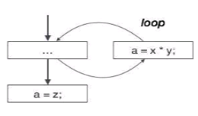
Partially dead code Elimination
There are some code statements whose computed values are used only under certain circumstances, i.e., sometimes the values are used and sometimes they are not.
Such codes are known as partially dead-code.

Slide 70
Loop Optimization (CO5)
Loop optimization is most valuable machine-independent optimization because program's inner loop takes bulk to time of a programmer.
If we decrease the number of instructions in an inner loop then the running time of a program may be improved even if we increase the amount of code outside that loop.

Slide 71
Code Motion
Code motion is used to decrease the amount of code in loop. This transformation takes a statement or expression which can be moved outside the loop body without affecting the semantics of the program.
For example:
In the while statement, the limit-2 equation is a loop invariant equation.
while (i<=limit-2) /*statement does not change limit*/
After code motion the result is as follows:
a= limit-2;
while(i<=a) /*statement does not change limit or a*/

Slide 72
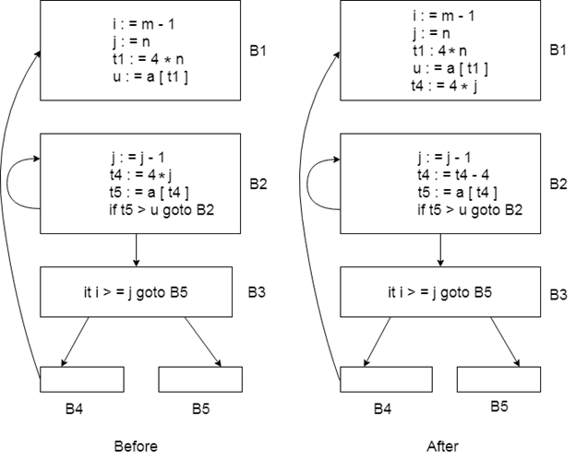
Induction-Variable Elimination
Induction variable elimination is used to replace variable from inner loop.
It can reduce the number of additions in a loop. It improves both code space and run time performance.

Slide 73
Reduction in Strength
Strength reduction is used to replace the expensive operation by the cheaper once on the target machine.
Addition of a constant is cheaper than a multiplication. So we can replace multiplication with an addition within the loop.
Multiplication is cheaper than exponentiation. So we can replace exponentiation with multiplication within the loop.

Slide 74
Example
Code After strength reduction the code will be
n the above code, it is cheaper to compute j=s than j=3 *i
while (i<10)
{
j= 3 * i+1;
a[j]=a[j]-2;
i=i+2;
}
s= 3*i+1;
while (i<10)
{
j=s;
a[j]= a[j]-2;
i=i+2;
s=s+6;
}

Slide 75
Loop Unrolling and Loop Jamming
Loop Unrolling- Duplicate the body of the loop multiple times, in order to decrease the no of times the loop condition is tested.
Loop Jamming- Combines the bodies of two adjacent loops that would iterate the same no of times.

Slide 76
Machine-dependent optimization
Machine-dependent optimization is done after the target code has been generated and when the code is transformed according to the target machine architecture.
It involves CPU registers and may have absolute memory references rather than relative references.
Machine-dependent optimizers put efforts to take maximum advantage of memory hierarchy.

Slide 77
Peephole Optimization (CO5)
Peephole optimization is a type of Code Optimization performed on a small part of the code. It is performed on the very small set of instructions in a segment of code
The small set of instructions or small part of code on which peephole optimization is performed is known as peephole or window.
It basically works on the theory of replacement in which a part of code is replaced by shorter and faster code without change in output.
Peephole is the machine dependent optimization.

Slide 78
Objectives of Peephole Optimization
The objective of peephole optimization is:
To improve performance
To reduce memory footprint
To reduce code size

Slide 79
Characteristics of peephole optimizations
Redundant-instructions elimination
Flow-of-control optimizations
Algebraic simplifications
Use of machine idioms
Unreachable

Slide 80
Redundant Loads And Stores
If we see the instructions sequence:
(1) MOV R0,a
(2) MOV a,R0
we can delete instructions (2) because whenever (2) is executed.
(1) will ensure that the value of a is already in register R0.

Slide 81
Unreachable Code
It is a part of program code that is never accessed because of program constructs.
The programmer may have accidently written a piece of code that can never be reached.
Eg:
void add_ten(int x)
{
return x+10;
printf (“value of x is %d,” x);
}

Slide 82
Flows-Of-Control Optimizations (CO5)
The unnecessary jumps can be eliminated in either the intermediate code or the target code by the following types of peephole optimizations. We can replace the jump sequence
Eg:
MOV R1, R2 MOV R1, R2
GoTo L1 GoTo L2
. .
L1: GoTo L2 L2: INC R1
L2: INC R1

Slide 83
Algebraic Simplification
There is no end to the amount of algebraic simplification that can be attempted through peephole optimization. Only a few algebraic identities occur frequently enough that it is worth considering implementing them. For example, statements such as
x := x+0 or
x := x * 1
are often produced by straightforward intermediate code-generation algorithms, and they can be eliminated easily through peephole optimization.

Slide 84
Reduction in Strength
Reduction in strength replaces expensive operations by equivalent cheaper ones on the target machine. Certain machine instructions are considerably cheaper than others and can often be used as special cases of more expensive operators.
For example, x² is invariably cheaper to implement as x*x than as a call to an exponentiation routine. Fixed-point multiplication or division by a power of two is cheaper to implement as a shift. Floating-point division by a constant can be implemented as multiplication by a constant, which may be cheaper.
X² → X*X

Slide 85
Use of Machine Idioms
The target machine may have hardware instructions to implement certain specific operations efficiently. For example, some machines have auto-increment and auto-decrement addressing modes. These add or subtract one from an operand before or after using its value. The use of these modes greatly improves the quality of code when pushing or popping a stack, as in parameter passing. These modes can also be used in code for statements like
i:=i+1.
i:=i+1 → i++
i:=i-1 → i- -

Slide 86
Directed Acyclic Graph (CO5)
Directed Acyclic Graph (DAG) is a tool that depicts the structure of basic blocks, helps to see the flow of values flowing among the basic blocks, and offers optimization too. DAG provides easy transformation on basic blocks.
DAGs are a type of data structure. It is used to implement transformations on basic blocks.
DAG provides a good way to determine the common sub-expression.
It gives a picture representation of how the value computed by the statement is used in subsequent statements.

Slide 87
Directed Acyclic Graph
A DAG for basic block is a directed acyclic graph with the following labels on nodes:
The leaves of graph are labeled by unique identifier and that identifier can be variable names or constants.
Interior nodes of the graph is labeled by an operator symbol.
Nodes are also given a sequence of identifiers for labels to store the computed value.

Slide 88
Algorithm for construction of DAG
Input: It contains a basic block
Output: It contains the following information:
Each node contains a label. For leaves, the label is an identifier.
Each node contains a list of attached identifiers to hold the computed values.

Slide 89
Example:
Question: Construct a DAG for the expression-
(a+b)*(a+b+c)
Solution:
Three Address Code:
t1=a+b
t2=t1+c
t3=t1*t2
t3
*
+
+
t2
t1
a
b
c

Slide 90
Example
Question: Construct the DAG for the following block-
a = b * c
d = b
e = d * c
b = e
f = b + c
g = d + f

Slide 91
Solution
Step 1: Step 3: Step 5:
Step 2: Step 4: Step 6:
+
f
*
a
*
a,e
a, e,b
*
b
c
d,b
c
d
c
*
g
+
+
*
a
a,e,b
a,e,b
*
d,b
c
d
c
d
c

Slide 92
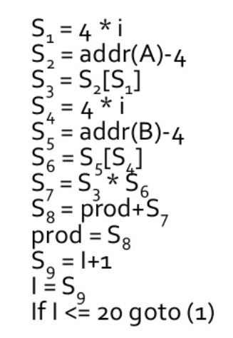
Example for Array Assignment
Question: Construct the DAG for Array Assignment

Slide 93
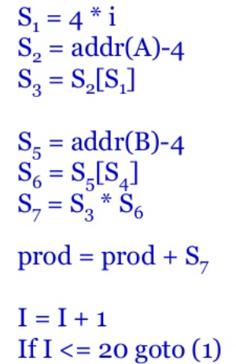
Example
Block after optimization

Slide 94
Application of DAG
Determining the Common Sub Expression.
Determining which names are used inside the block & computed outside the block.
Determining which statements of the block could have their computed value outside the block.
Simplify the list of quadruples by eliminating common sub expression.

Slide 95
Value Numbering (CO5)
It is compiler based program analysis method
That allow redundant computation to be removed
A simple way to represent DAG is via Value numbering
While searching DAG representation using pointer is inefficient, value numbering uses hash table and hence it is very efficient.
Central idea is to assign number( called value number) to expression in such a way that two expression receive the same number if the compiler can prove that they are equal for all possible program input.

Slide 96
Value Numbering
The algorithm uses three tables indexed by appropriate hash values:
HashTable,
ValnumTable,
NameTable
Can be used to eliminate common sub-expressions, do constant folding, and constant propagation in basic blocks
Can take advantage of commutativity of operators, addition of zero, and multiplication by one

Slide 97
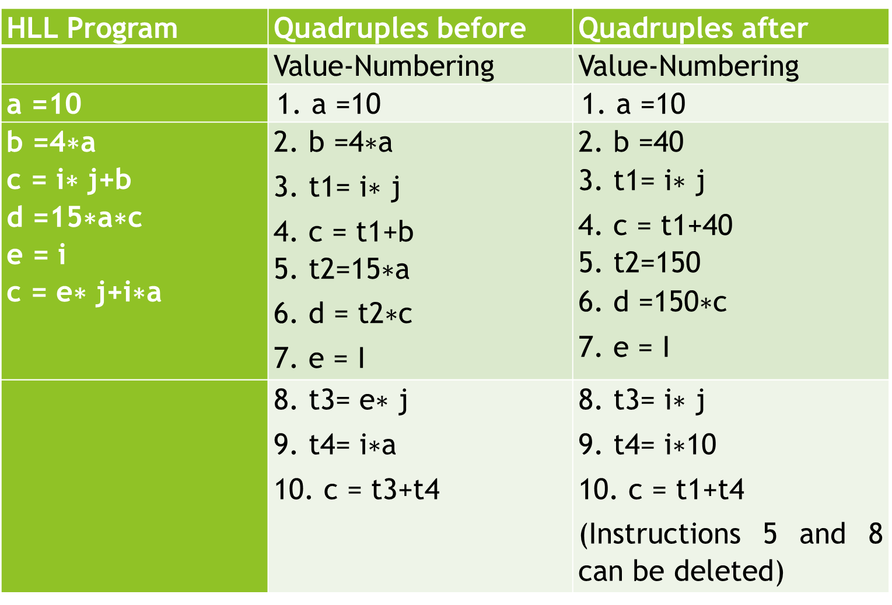
Example

Slide 98
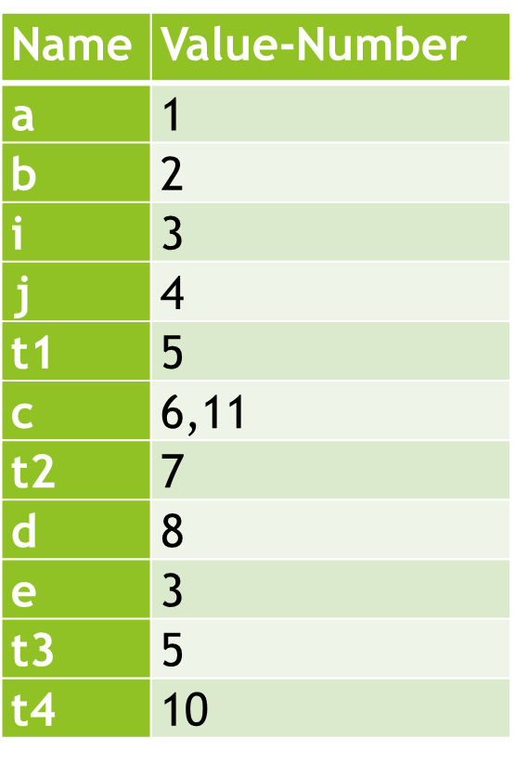
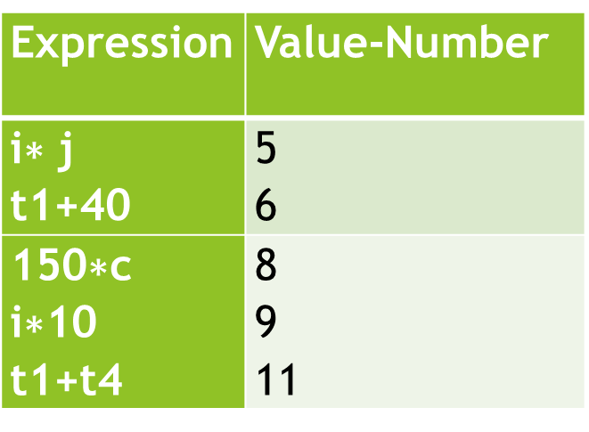
Hash Table & ValNum Table
ValNum TABLE
HASH TABLE

Slide 99
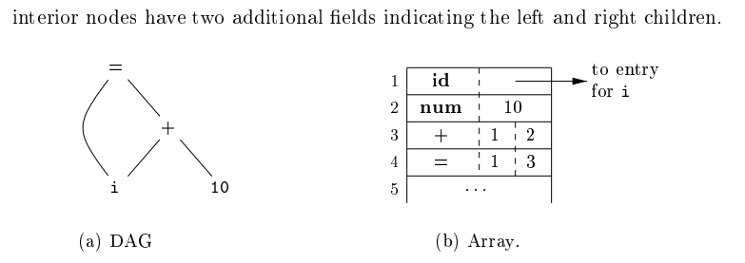
Value-Number Method for Constructing DAG’s
Nodes of a DAG for i=i + 10 allocated in an array

Slide 100
Algebraic Law (CO5)
Commutative Law:
Search for i*j in Hash Table fails, than try for j*I
Quadruple x=i+0 replaced x=I
Y=j+1 to y=j
Quad whose LHS variables are used later can be marked as useful.

Slide 101
Global Data Flow Analysis (CO5)
Based on the local information a compiler can perform some optimizations. For example, consider the following code:
x = a + b;
x = 6 * 3
In this code, the first assignment of x is useless. The value computer for x is never used in the program.
At compile time the expression 6*3 will be computed, simplifying the second assignment statement to x = 18;

Slide 102
Global Data Flow Analysis
Some optimization needs more global information. For example, consider the following code:
a = 1;
b = 2;
c = 3;
if (....) x = a + 5;
else x = b + 4;
c = x + 1;
In this code, at line 3 the initial assignment is useless and x +1 expression can be simplified as 7.

Slide 103
Global Data Flow Analysis
A more global analysis is required so that the compiler knows the following things at each point in the program:
Which variables are guaranteed to have constant values
Which variables will be used before being redefined
Data flow analysis is used to discover this kind of property. The data flow analysis can be performed on the program's control flow graph (CFG).
The control flow graph of a program is used to determine those parts of a program to which a particular value assigned to a variable might propagate

Slide 104
Global Data Flow Analysis
Data-flow information can be collected by setting up and solving systems of equations of the form :
out [S] = gen [S] U ( in [S] - kill [S] )
out[S]-Information at the end of S
gen[S]-Information generated by S
in[S]- Information enters at the beginning of S
kill[S]- Information killed by S

Slide 105
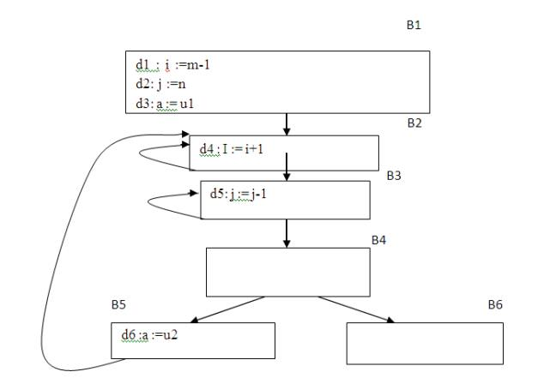
Global Data Flow Analysis
Points and Paths:
Within a basic block, the point between two adjacent statements, as well as the point before the first statement and after the last. Thus, block B1 has four points: one before any of the assignments and one after each of the three assignments.

Slide 106
Global Data Flow Analysis
A path from p1 to pn is a sequence of points p1, p2,….,pn such that for each i between 1 and n-1, either
1. Pi is the point immediately preceding a statement and pi+1 is the point immediately following that statement in the same block, or
2. Pi is the end of some block and pi+1 is the beginning of a successor block.

Slide 107
Global Data Flow Analysis
Reaching definitions
Definition d reaches a point p if there is a path from the point immediately following d to p, such that d is not “killed” along that path.
Thus a point can be reached by an unambiguous definition and an ambiguous definition of the appearing later along one path.

Slide 108
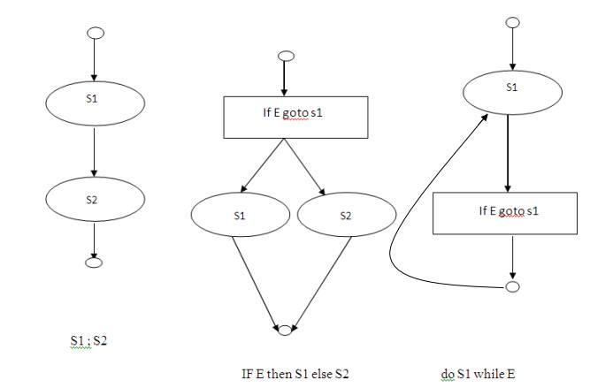
Data-flow analysis of structured programs
S->id: = E| S; S | if E then S else S | do S while E
E->id + id| id

Slide 109
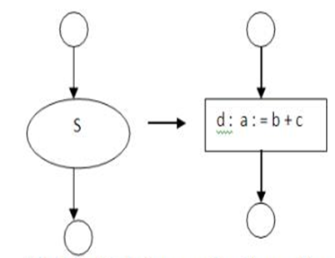
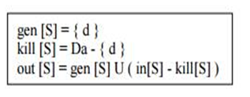
Global Data Flow Analysis
Data-flow equations for reaching definitions :
1. S->id: = E| S; S | if E then S else S | do S while E
E->id + id| id

Slide 110
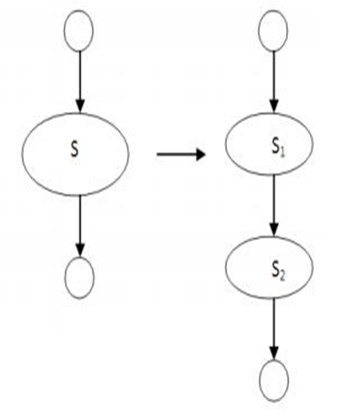
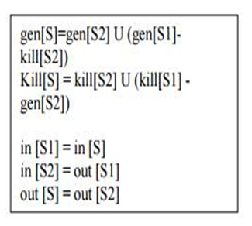
Global Data Flow Analysis
2. S->id: = E| S; S | if E then S else S | do S while E
E->id + id| id

Slide 111
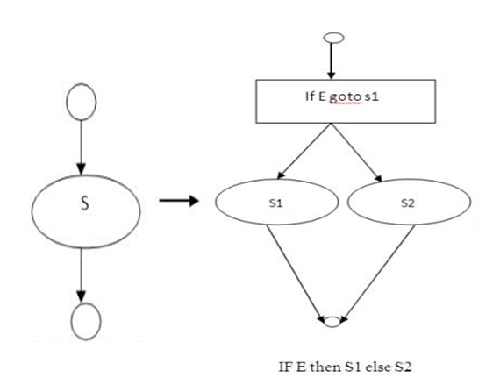
Global Data Flow Analysis
3. S->id: = E| S; S | if E then S else S | do S while E
E->id + id| id

Slide 112
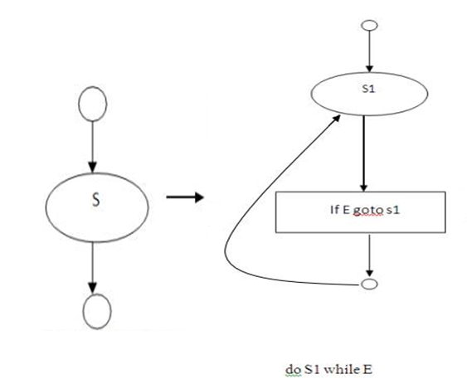
Global Data Flow Analysis
4. S->id: = E| S; S | if E then S else S | do S while E
E->id + id| id

Slide 113
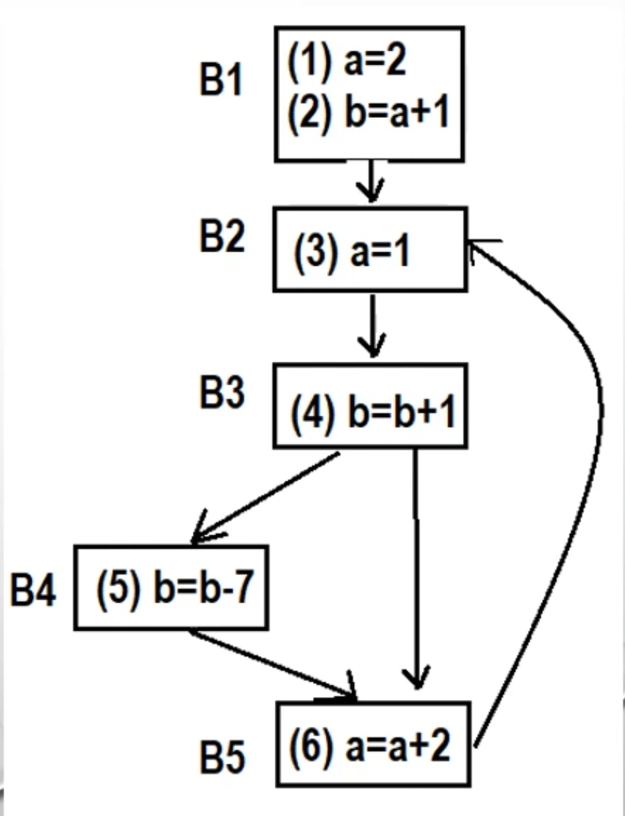
Global Data Flow Analysis
Example-

Slide 114
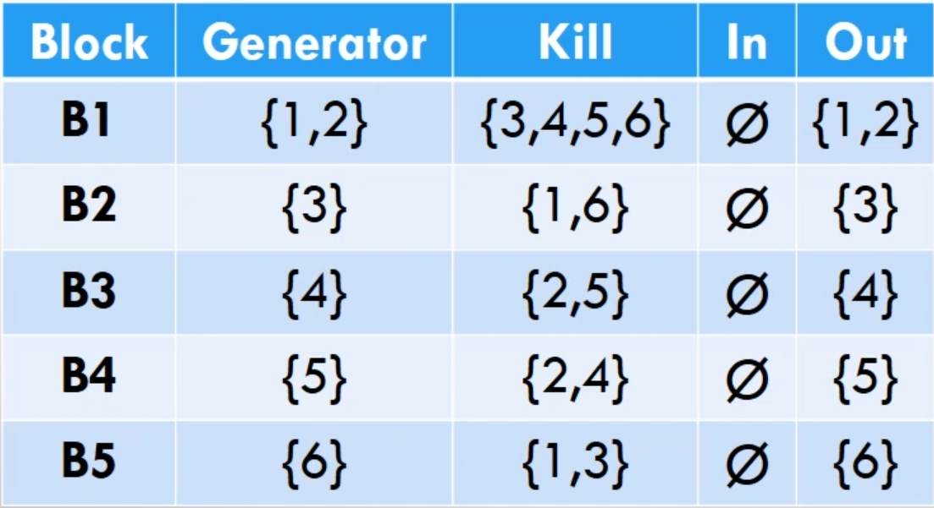
Global Data Flow Analysis
Iteration 1-

Slide 115
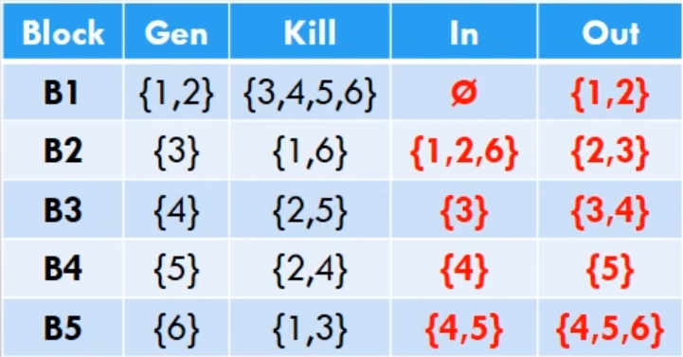
Global Data Flow Analysis
Iteration 2-

Slide 116
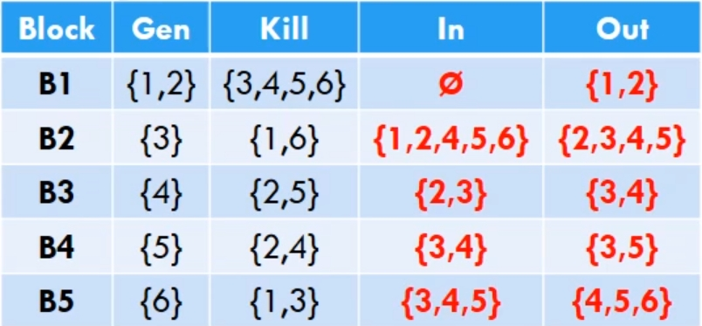
Global Data Flow Analysis
Iteration 3-

Slide 117
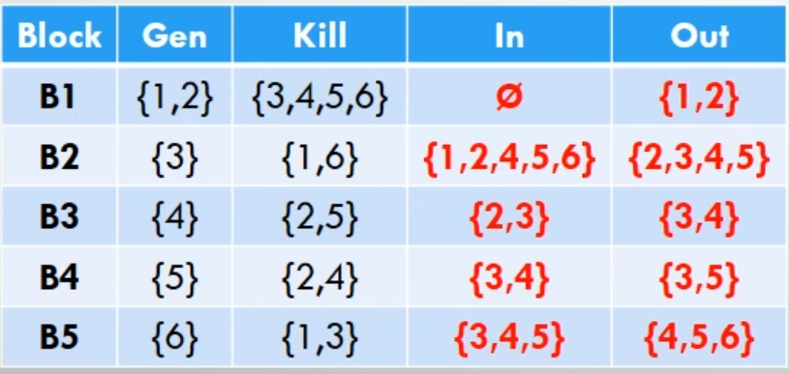
Global Data Flow Analysis
Iteration 4-

Slide 118
Faculty Video Links, Youtube & NPTEL Video Links and Online Courses Details
Youtube/other Video Links
https://www.youtube.com/watch?v=O5YlRUYFDA8
https://www.youtube.com/watch?v=AKYuP3vpdlg
https://www.youtube.com/watch?v=clb4tnEm8l4
https://www.youtube.com/watch?v=Zz94_c-xFvA&t=950s

Slide 119
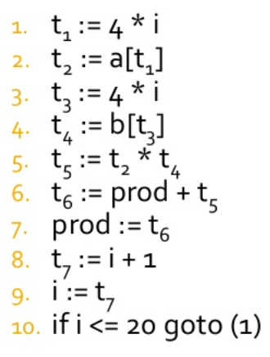
Daily Quiz
Question- Construct a DAG representation

Slide 120
Daily Quiz
Reduction in strength means
Replacing run time computation by compile time computation
Removing loop invariant computation
Removing common subexpression
Replacing a costly operation by a cheaper one
Replacing a variable with constant which has been assigned to it earlier during compilation is
Local optimization
Loop optimization
Constant propagation
Code Motion

Slide 121
Daily Quiz
The graph that shows basic blocks and their successor relationship is called
Hamilton Graph
Control Graph
Flow Graph
Directed Acyclic Graph
Objectives of code optimization are,
Production of target program with high execution efficiency
Reduction of the space occupied by the program
Time efficient program that takes lesser compilation time
All of the above

Slide 122
Daily Quiz
A directed acyclic graph represents one form of intermediate representation. The number of internal nodes in DAG of an expression, a = (b+c)*(b+c) is
2
3
4
5
Running time of a program depends on
The way the registers and addressing modes are used
The order in which computations are performed
The usage of machine idioms
All of these

Slide 123
Daily Quiz
DAG representation of a basic block allows
Automatic detection of local common sub expressions
Automatic detection of induction variables
Automatic detection of loop variant instructions
None of the above
Replacing a variable with constant which has been assigned to it earlier during compilation is
Local optimization
Loop optimization
Constant propagation
Code Motion

Slide 124
Daily Quiz
A directed acyclic graph represents one form of intermediate representation. The number of internal nodes in DAG of an expression,
a = (b+c)*(b+c) is
2
3
4
5
Intermediate representation of the source program produced by the front end can in the form of
Three address representation
Postfix notation
Syntax Trees and DAG’s
All of the above

Slide 125
Weekly Assignments-1
What is DAG ? What are its advantages in context of optimization ?
What is data flow analysis ? How does it use in code optimization?
Explain what constitute a loop in a flow graph and how will you do loop optimizations in code optimization of a compiler.
How DAG is created from three address code ? Write algorithm for it and explain it with a relevant example.
What are different issues in code optimization ? Explain it with proper example.

Slide 126
Weekly Assignments-2
Define the Global Data Flow Analysis
Write short Note on:
Loop unrolling
Loop Jamming
Construct DAG for the following expression (a + b) - (e - (c + d))
Explain the concept of Global data-flow analysis
Write role of flow of control statement.

Slide 127
MCQ
The specific task storage manager performs
allocation/ deallocation of storage to programs
protection of storage area allocated to a program from illegal access by other programs in the system
the status of each program
both ( a ) and ( b )
Hamming Distance is
a theoretical way of measuring errors
a technique for assigning codes to a set of items known to occur with a given probability
a technique for optimizing the intermediate code
None of the above

Slide 128
MCQ
What will be the locally optimized code for the statement X=(A-B)*C-D/(A-B)?
No change, already localized
There is nothing like locally optimized
There is syntax error
None of the above
An optimizing compiler
is optimized to occupy less space
is optimized to take less time for execution
optimizes the code
All of the above

Slide 129
MCQ
The method which merges the bodies of two loops is
Loop rolling
Loop Jamming
Constant folding
None of these
DAG representation of a basic block allows
Automatic detection of local common sub expressions
Automatic detection of induction variables
Automatic detection of loop variant instructions
None of the above

Slide 130
MCQ
DAG is used for
a) Identifying common sub expression in expression
b) Identifying parse tree for expression
c) Identifying syntax tree for expression
d) Both b & c
The method which merges the bodies of two loops is
Loop rolling
Loop Jamming
Constant folding
None of these

Slide 131
MCQ
Optimization of the program that works within a single basic block is called
Local optimization
Global optimization
Loop un-controlling
Loop controlling
The optimization which avoids test at every iteration is
Loop unrolling
Loop jamming
Constant folding
None of the mentioned

Slide 132
Glossary Questions
Q1. What is code motion?
Q2. What are the properties of optimizing compiler?
Q3. What are the basic goals of code movement?
Q4. Mentions the issues to be considered while applying the techniques for code optimization?
Q5. What is basic block?
Q6. What is DAG? Mention its applications.

Slide 133
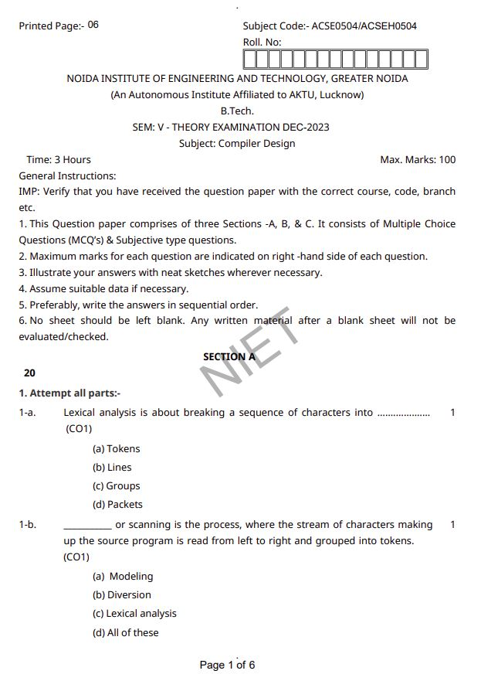
Old Question Paper

Slide 134
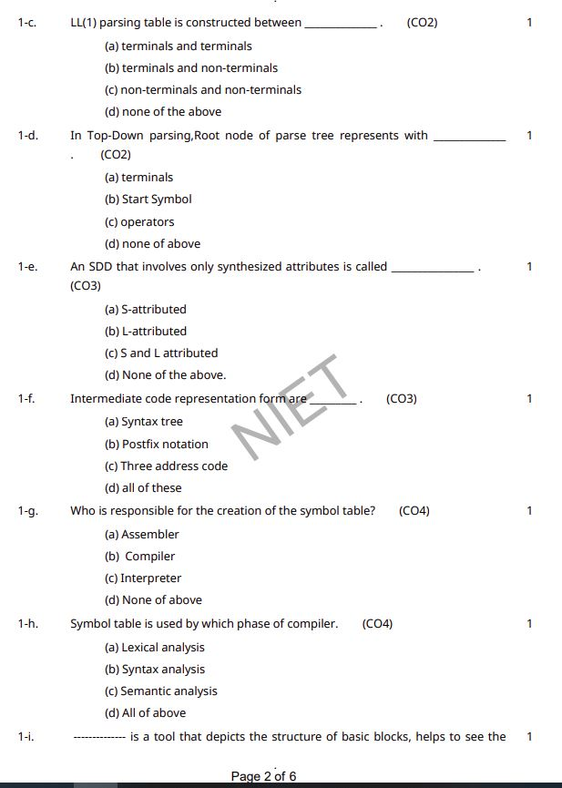
Old Question Paper

Slide 135
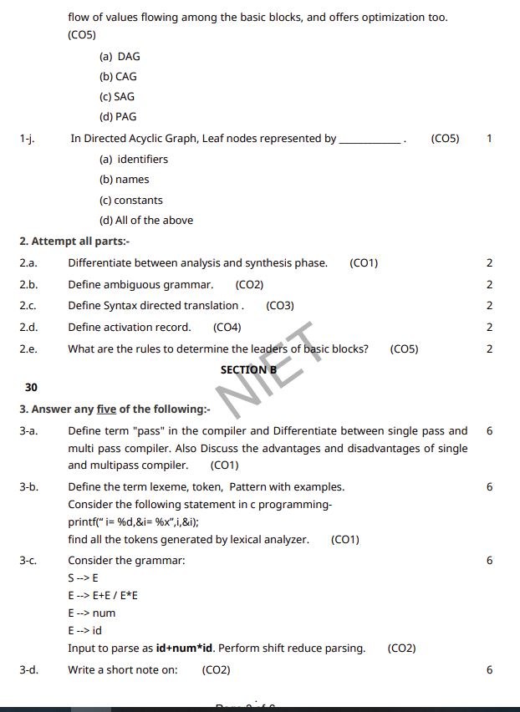
Old Question Paper

Slide 136
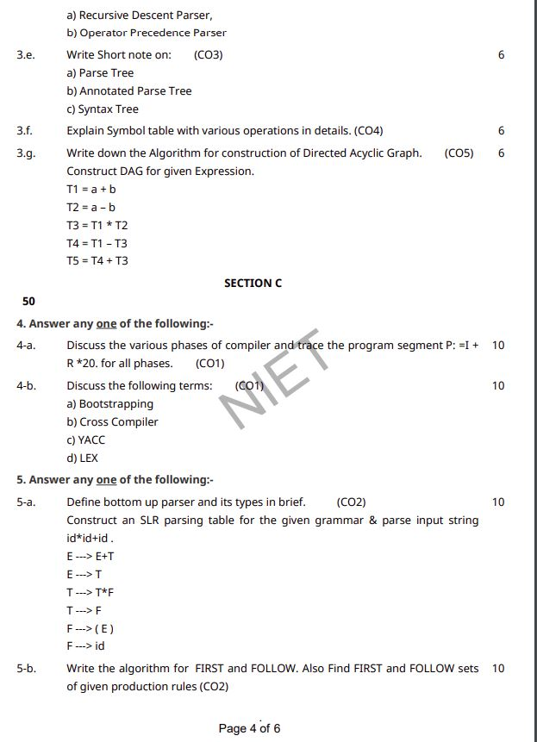
Old Question Paper

Slide 137
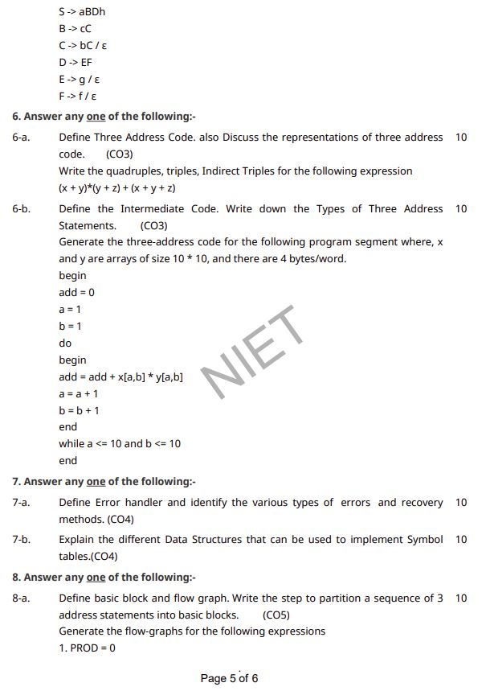
Old Question Paper

Slide 138
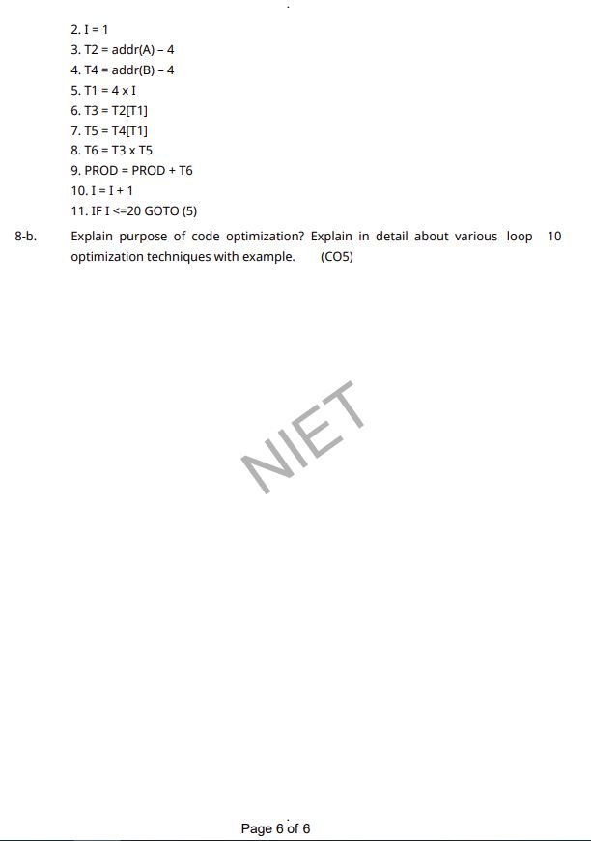
Old Question Paper

Slide 139
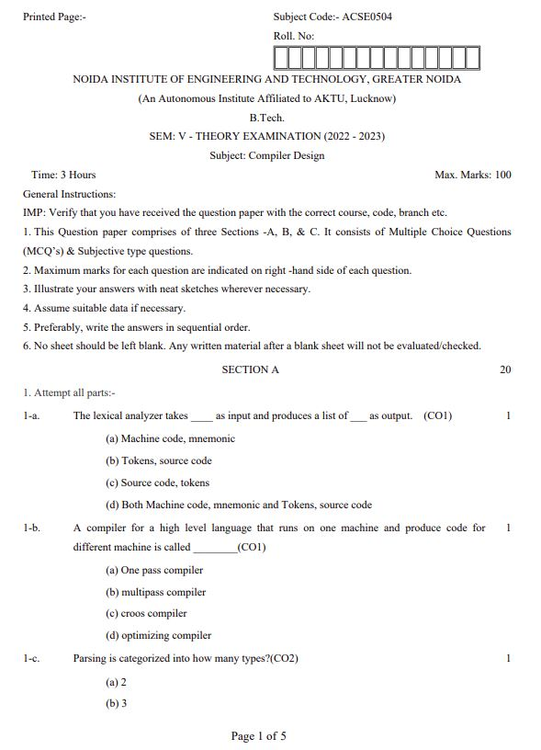
Old Question Paper

Slide 140
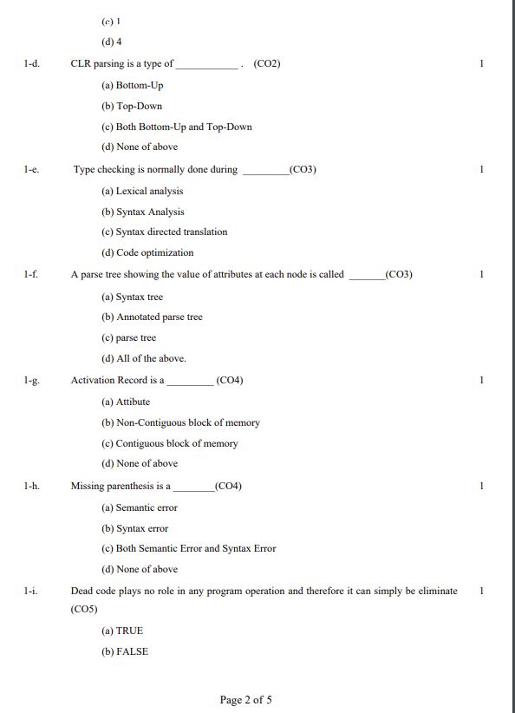
Old Question Paper

Slide 141
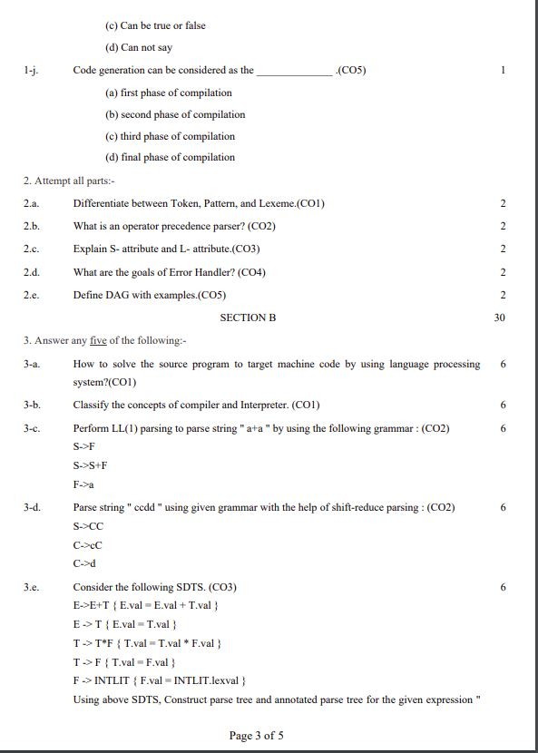
Old Question Paper

Slide 142
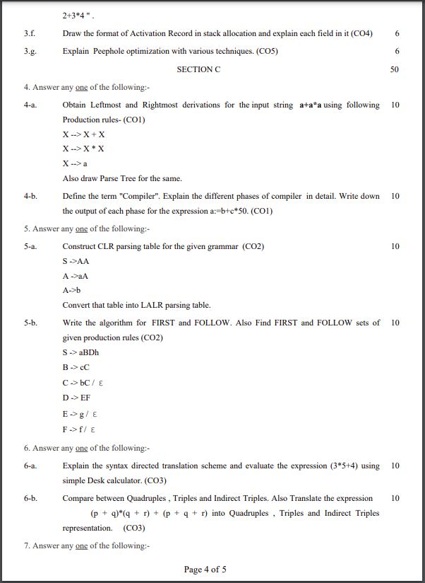
Old Question Paper

Slide 143
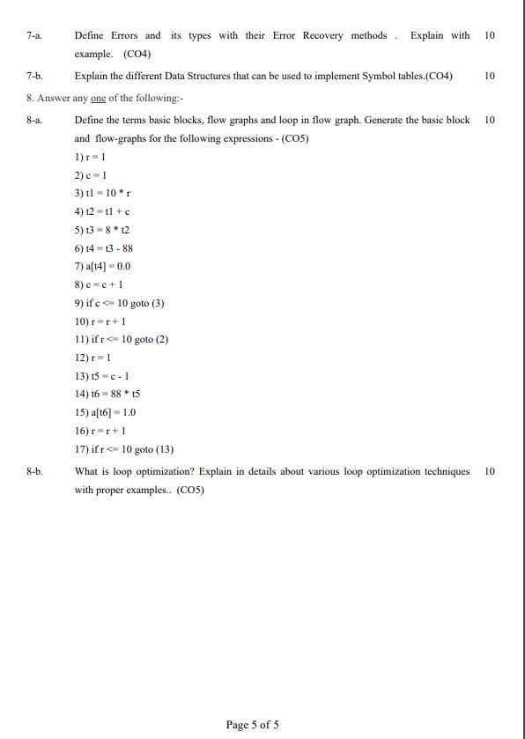
Old Question Paper

Slide 144
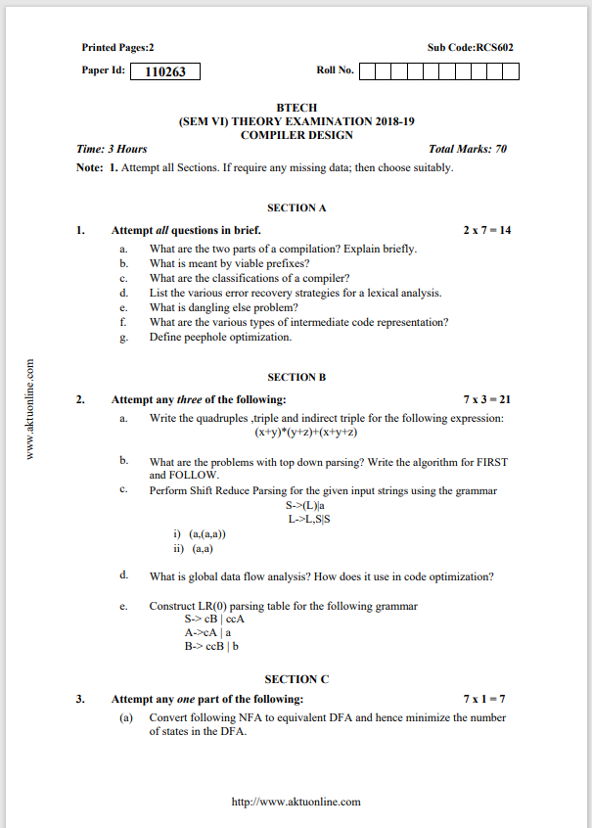
Old Question Paper

Slide 145
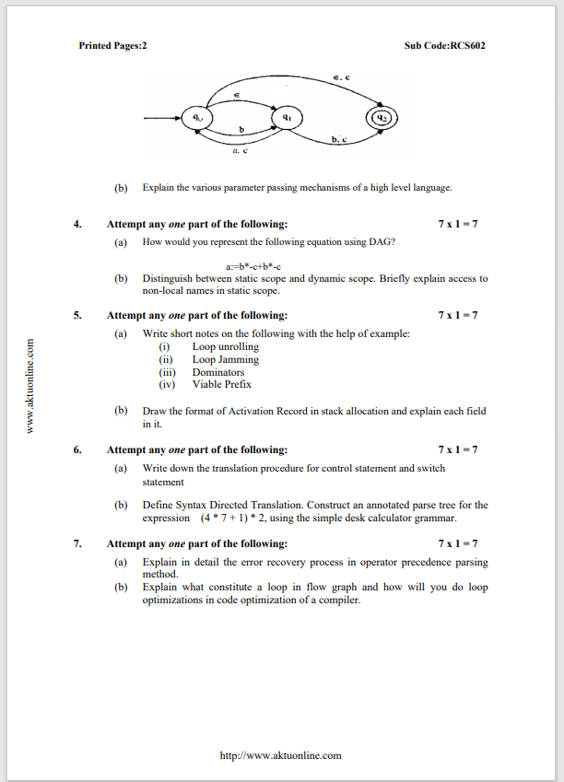
Old Question Paper

Slide 146
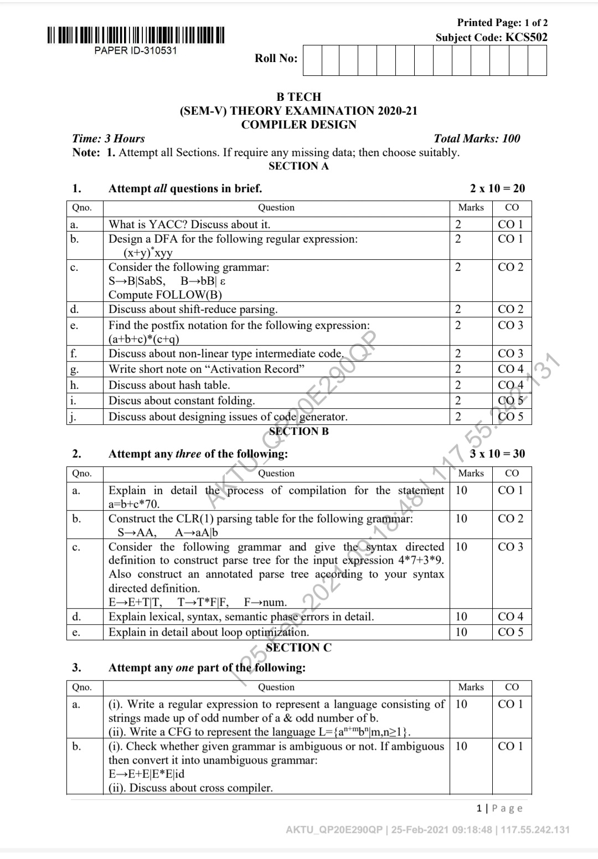
Old Question Paper

Slide 147
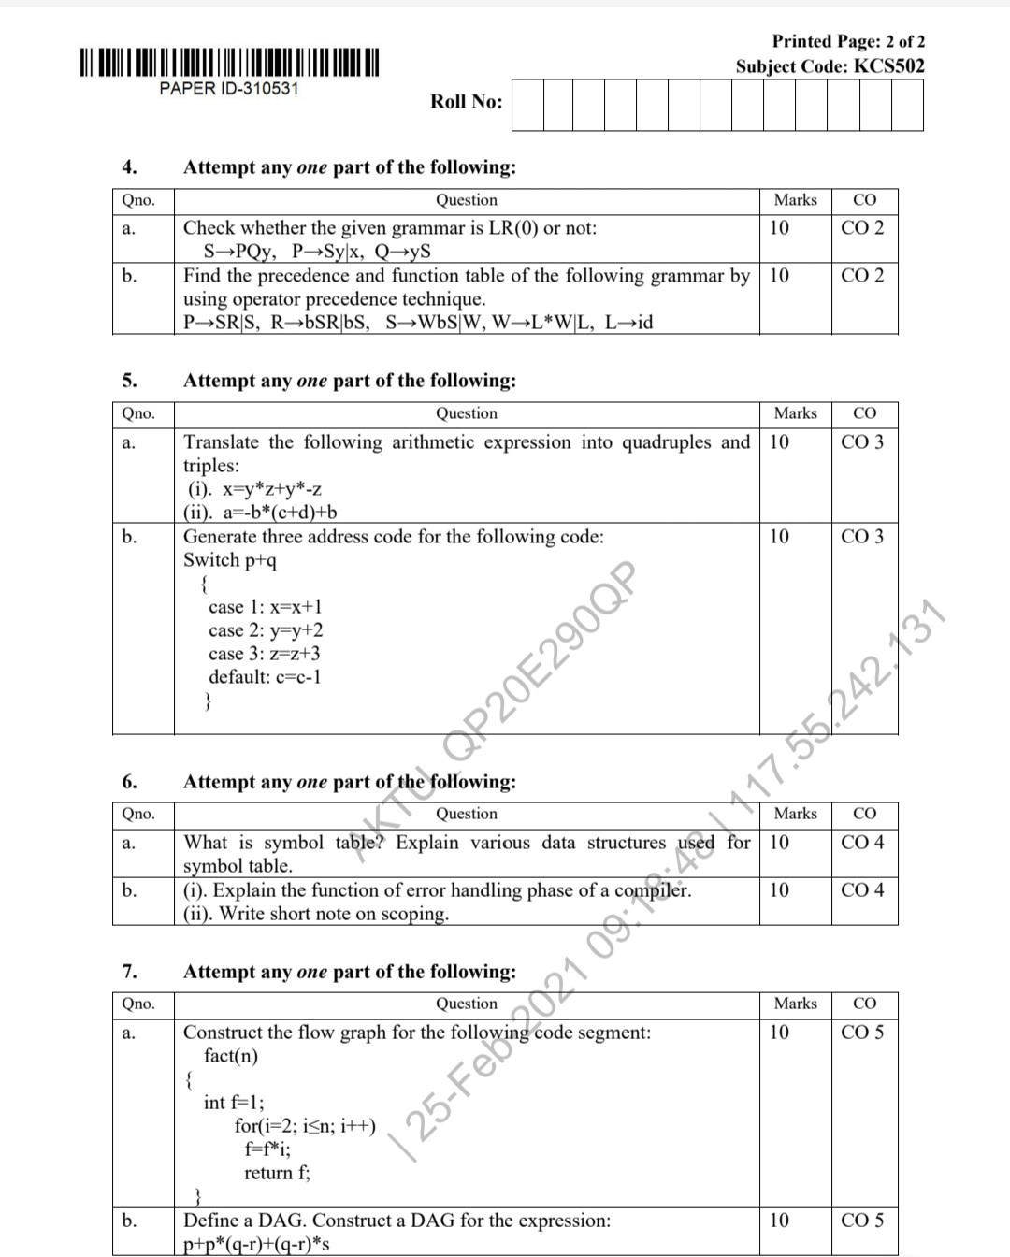
Old Question Paper

Slide 148
Expected Question for University Exam
Define a directed acyclic graph. Construct a DAG and write the sequence of instructions for the expression a+a*(b-c)+(b-c)*d.
Discuss in detail the process of optimization of basic blocks. Give an example
Write an algorithm to partition a sequence of three address statements into basic blocks.
Represent the following in flow graph i=1;sum=0;while (i<=10){sum+=i;i++}

Slide 149
Recap of Unit
During code generation process the symbol table entries have to be mapped to actual addresses and levels have to be mapped to instruction address.
Local variables are stack allocation in the activation record while global variables are in static area.
Register can be accessed faster than memory. The instructions involving operands in register are shorter and faster than those involving in memory operand.
The target computer is a type of byte-addressable machine. It has 4 bytes to a word. The target machine has n general purpose registers, R0, R1,...., Rn-1.
Partitioning three-address code into basic blocks
Input: A sequence of three address instructions.
Process: Instructions from intermediate code where leaders are determined.

Slide 150
References
K. Muneeswaran,Compiler Design,First Edition,Oxford University Press.
J.P. Bennet, “Introduction to Compiler Techniques”, Second Edition, Tata McGraw-Hill,2003.
Henk Alblas and Albert Nymeyer, “Practice and Principles of Compiler Building with C”, PHI, 2001.
Aho, Sethi & Ullman, "Compilers: Principles, Techniques and Tools”, Pearson Education
V Raghvan, “ Principles of Compiler Design”, TMH
Kenneth Louden,” Compiler Construction”, Cengage Learning.
Charles Fischer and Ricard LeBlanc,” Crafting a Compiler with C”, Pearson Education

Slide 151
Thank You

